Slide 1
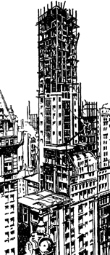
Architecture & Frameworks
Enda Stafford

Slide 2
Architecture & Frameworks
frame·work (frām'wûrk')
n.
A structure for supporting or enclosing something else, especially a skeletal support used as the basis for
something being constructed.
An external work platform; a scaffold.
A fundamental structure, as for a written work.
A set of assumptions, concepts, values, and practices that constitutes a way of viewing reality.
The American Heritage® Dictionary of the English Language, Fourth Edition
Copyright © 2009 by Houghton Mifflin Company.
Published by Houghton Mifflin Company. All rights reserved.
1. Application Characteristics
2. Software Architecture
3. Patterns and Design
4. Frameworks

Slide 3
1. Application Characteristics
Application Attributes
Performance
Localizable
Integration
Scalability
Security
Concurrency
Business Rules
Data Persistence

Slide 4
1. Application Characteristics
Application Design
  Disparate business scenarios
  Different businesses will require different application types
  Competitive edge
  Driven by requirements
  Alternative designs
  No single architecture
  Need to handle large transaction volumes and large datasets
Notes:
Come back to the ideas of architecture and design

Slide 5
1. Application Characteristics
Application Development Challenges
  React quickly to changing business requirements.
  Adopt new technologies
Development Constraints
  Time
  Money
  Need to maintain and leverage existing information assets
  Security
  Predictability
Notes:
Triple constraints……………………….Scope…..Cost….Time

Slide 6


1. Application Characteristics
To summarise:
  Applications can be
  Building applications may be
COMPLEX!
DIFFICULT!

Slide 7
2. Software Architecture
How do we manage complexity & requirements?
  Software Architecture
  Patterns and Design
  Frameworks
  Software Development Methodologies

Slide 8
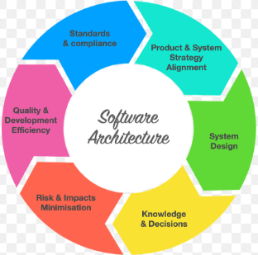
2. Software Architecture
How do we manage complexity & requirements?
  Software Architecture
  Patterns and Design
  Frameworks
  Software Development Methodologies

Slide 9
2. Software Architecture
What is software architecture?
  Addresses structural concerns
  Addresses behavioural concerns
  Focuses on the significant elements
  Software systems exist to meet the expectations of stakeholders
    Trade-offs may be required to balance stakeholder needs
    Expectations expressed as functional and non-functional requirements
  Important, key decisions are made early in the development process
  Lays out the foundations for the system
  Influenced by its environment
Notes:
Typical stakeholders:
Client, Acquirer, Owner, User, Operator, Architect, System Engineer, Developer, Designer, Builder, Maintainer, Service Provider, Vendor, Subcontractor, Planner
Structural concerns – What the system will do…..The system WILL do…..
Behavioural concerns – Quality of the system….how it will achieve the system goals….The system SHALL be able to

Slide 10
2. Software Architecture
What is software architecture?
Philippe Kruchten, Grady Booch, Kurt Bittner, and Rich Reitman define software architecture as follows:
‘Software architecture encompasses the set of significant decisions about the organization of a software system including the selection of the structural elements and their interfaces by which the system is composed; behaviour as specified in collaboration among those elements; composition of these structural and behavioural elements into larger subsystems; and an architectural style that guides this organization. Software architecture also involves functionality, usability, resilience, performance, reuse, comprehensibility, economic and technology constraints, trade-offs and aesthetic concerns..’
[Note: this definition is a refinement of the description of software architecture from “Software Architecture: Perspectives on an Emerging Discipline”, Mary Shaw and David Garland, Prentice Hall,1996]

Slide 11
2. Software Architecture
What is software architecture?
ANSI/IEEE standard 1471, “Recommended Practice for Architectural Description of Software-intensive Systems”, has the following definition:
Architecture is the fundamental organization of a system embodied in its components, their relationships to each other, and to the environment, and the principles guiding its design and evolution.
This standard also defines the following terms related to this definition:
A system is a collection of components organized to accomplish a specific function or set of functions. The term system encompasses individual applications, systems in the traditional sense, subsystems, systems of systems, product lines, product families, whole enterprises, and other aggregations of interest. A system exists to fulfil one or more missions in its environment.
The environment, or context, determines the setting and circumstances of developmental, operational, political, and other influences upon that system.
A mission is a use or operation for which a system is intended by one or more stakeholders to meet some set of objectives.
A stakeholder is an individual, team, or organization (or classes thereof) with interests in, or concerns relative to, a system.
Notes:
A software-intensive system is any system in which software is essential to implementation and deployment.
See also http://www.iso.org/iso/iso_catalogue/catalogue_tc/catalogue_detail.htm?csnumber=45991

Slide 12
2. Software Architecture
What is software architecture?
Len Bass, Paul Clements, and Rick Kazman, “Software Architecture in Practice”, 2nd Edition, Addison Wesley, 2003, have the following definition:
The software architecture of a program or computing system is the structure or structures of the system, which comprise software elements, the externally visible properties of those elements, and the relationships among them.
Martin Fowler, “Patterns of Enterprise Application Architecture”, Addison Wesley, 2002, states:
…if you find that something is easier to change than you once thought, then it's no longer architectural. In the end architecture boils down to the important stuff—whatever that is.

Slide 13
3. Patterns & Design
Basic Design Principles
  Programming Design Principles
    Cohesion
      A cohesive software module (subroutines, classes, libraries) features a set of responsibilities that are strongly related
      High cohesion is desirable as maintenance and reusability aspects are increased due to minimising dependencies
      Cohesion is inversely proportional to the number of responsibilities a module has.
    Coupling
      A measure of the dependency between two software modules
      For example, module A and module B exhibit high coupling when any change to module A necessitates a change to module B
      Low coupling is desirable. Modules do not have to be completely isolated, however, communication should occur through well-defined, stable interfaces
    High cohesion/Low coupling facilitates system testing, code reuse, greater ability for developers to understand and maintain code
Notes:
Cohesion and Coupling introduced in “Structured Design: Fundamentals of Computer Program and Systems Design”, L. Constantine and E. Yourdon, Yourdon Press, 1976.

Slide 14
3. Patterns & Design
Basic Design Principles
  Indications of Bad Design
    Software is characterised by being resistant to change
      A change in one module requires making multiple further changes in other modules
    Resists reuse / Immobility
      Code cannot easily be reused due to number and depth of dependencies
    Software resists modifications to fix core issues and invites workarounds instead
      Due to unnecessary dependencies and lack of cohesion
Notes:
Cohesion and Coupling introduced in “Structured Design: Fundamentals of Computer Program and Systems Design”, L. Constantine and E. Yourdon, Yourdon Press, 1976.

Slide 15
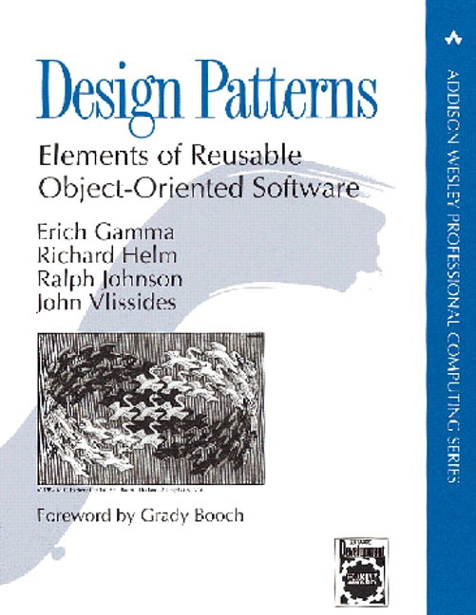
3. Patterns & Design
Object Oriented Design
‘Designing object-oriented software is hard, and designing reusable object-oriented software is even harder. You must find pertinent objects, factor them into classes at the right granularity, define class interfaces and inheritance hierarchies, and establish key relationships among them. Your design should be specific to the problem at hand but also general enough to address future problems and requirements.’
“Design Patterns: Elements of Reusable Object-Oriented Software”,The Gang of Four (GoF), Erich Gamma, Richard Helm, Ralph Johnson, and John Vlissides, Addison-Wesley, 1994

Slide 16
3. Patterns & Design
Patterns
  Patterns result from a generalisation of design principles into building blocks
  We use patterns as design solutions
  We can consider two categories of patterns
    Design patterns
    Architectural patterns
Notes:
Design….Factory classes/FactoryImpl classes i.e. a template
Arch…MVC, REST

Slide 17
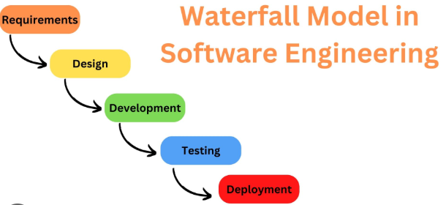
4. Software Development Methodologies
Waterfall
  Clunky methodology
  Sequential steps
  Well formed methodology
    Upfront planning
    Limited flexibility

Slide 18
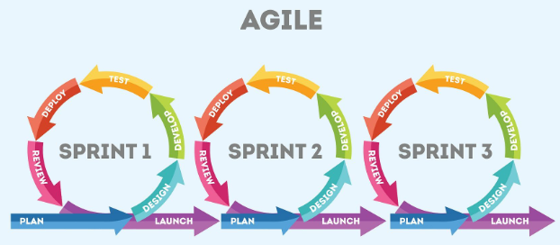
4. Software Development Methodologies
Agile / Scrum / Kanban / JIT
  Streamlined methodology
  Iterative design
  Short design cycles
  Testing and feedback
  Continuous Improvement

Slide 19
5. Frameworks
  What is a Framework?
    A tool used to improve the software development process
    ‘… a set of cooperating classes that make up a reusable design for a specific class of software.’
    ‘… a reusable design expressed as a set of abstract classes and the way their instances collaborate.’
    ‘… an extendable set of objects for related functions.’
      where ‘… a set of related functions is the set that defines the area of expertise or competencies of the framework.’
    ‘… a reusable, `semi-complete` application that can be specialised to produce custom applications.’
    ‘… a software piece that an application can start with as a basis.’
Notes:
Dictionary Definition

Slide 20


5. Frameworks
  The Hollywood Principle: ‘Don’t call us, we’ll call you!!’
    Frameworks exhibit ‘Inversion of Control’. The framework manages the flow of control between objects. The developer writes code that the framework calls. The framework will determine which methods to invoke in response to events.
    Inversion of Control is a key characteristic of frameworks.
Go Greyhound … and leave the driving to us.

Slide 21
5. Frameworks
  Characteristics of Frameworks
    Extensibility
      A framework will provide a basic construct implementing a set of design patterns and application domain logic
      Extension points include
        Base classes which can be sub-classed
        Methods can be overwritten
        Interfaces to allow external classes to hook into the framework
      Provides ‘hook’ methods or ‘hotspots’ for implementing variability of functionality
    Modularity
      Localise the impact of design and implementation changes
      Use abstract classes and stable interfaces to encapsulate and localise change
      Applications built using the framework have to conform to the interfaces provided by the framework
    Reusability
      Of design
      Of analysis
      Of code
    Inversion of Control
      Implementation of the ‘Observer’ design pattern
Sample Frameworks?

Slide 22

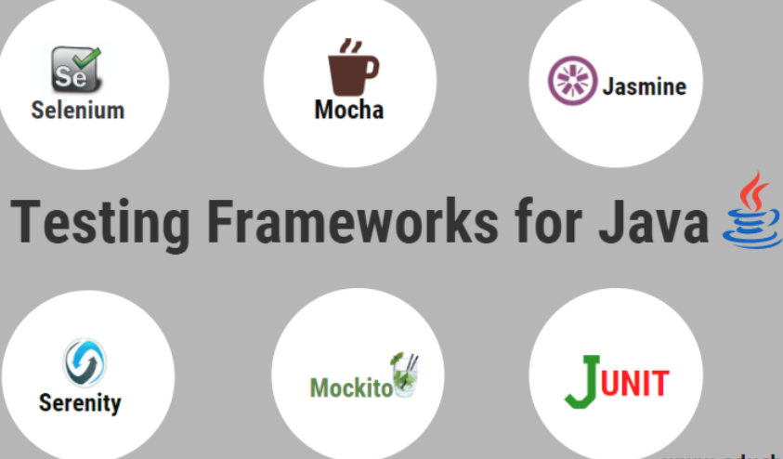

5. Frameworks
Notes:
OSI
SOAP

